Slide 2
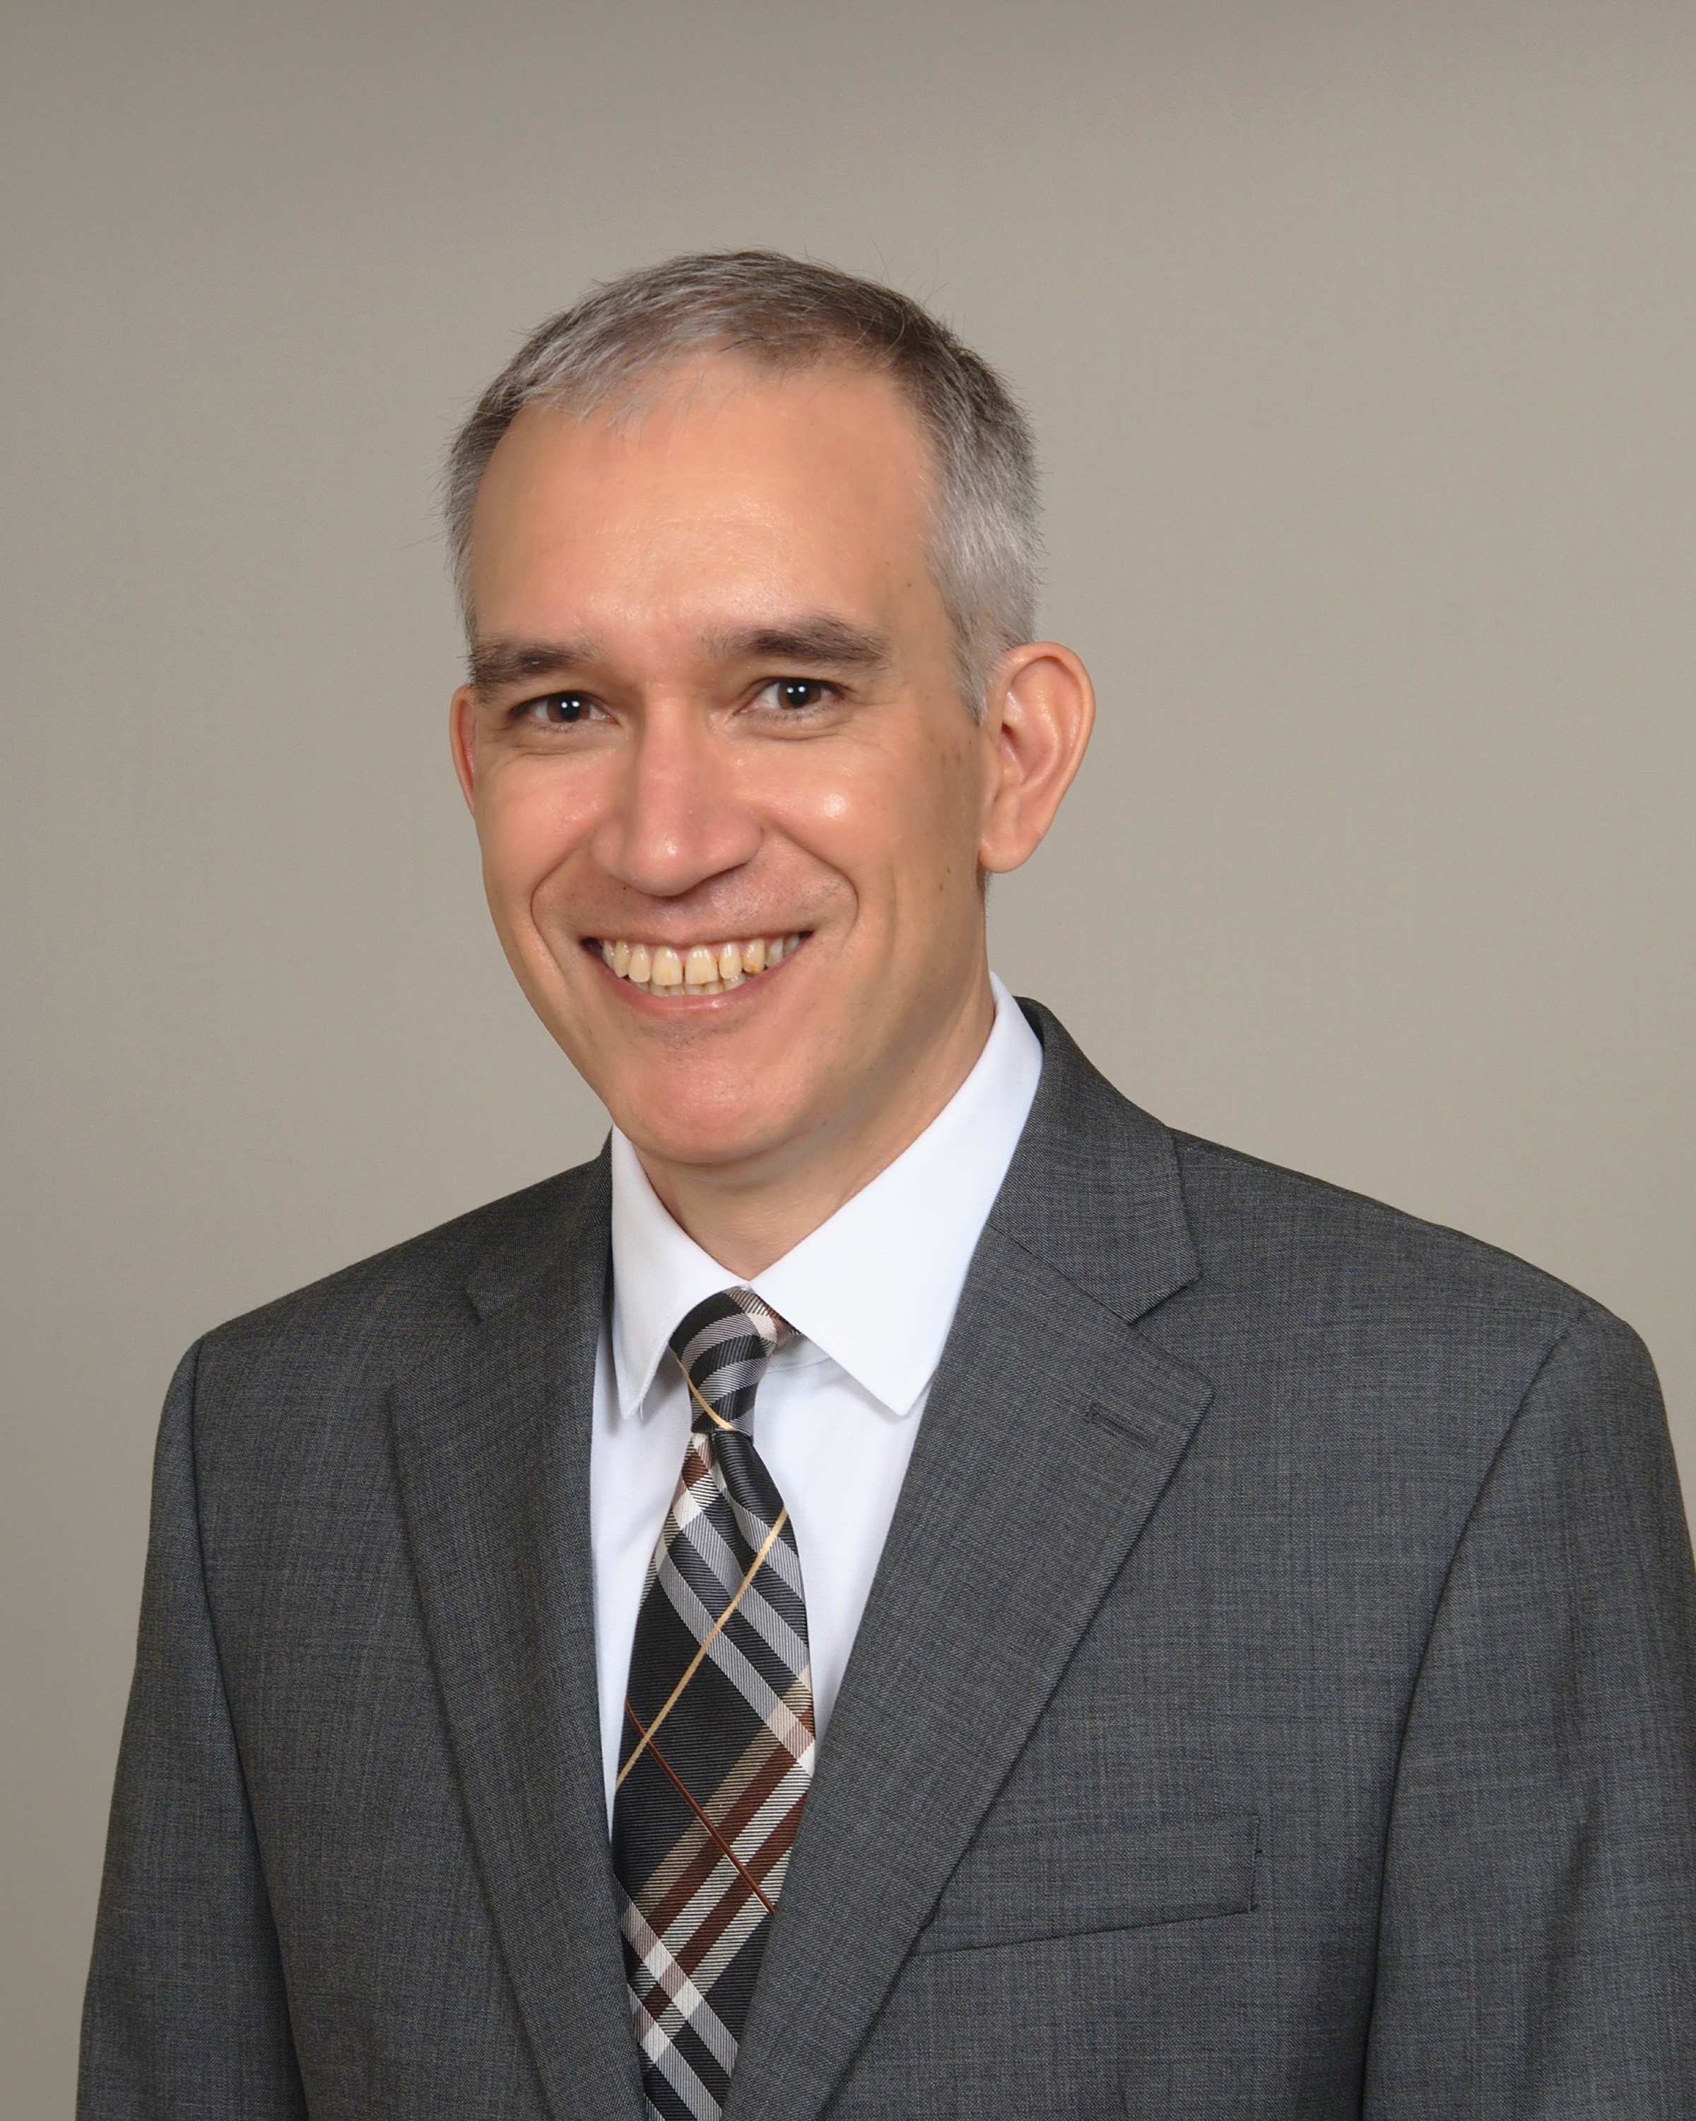
Matthew Wong, MD
Insert Picture
Matthew Wong, MD is a clinical neurologist and Clinical Assistant Professor specializing in neurology and epilepsy care at Wake Forest University School of Medicine. He earned his medical degree from McMaster University in Ontario, Canada, and completed his neurology residency as well as a fellowship in clinical neurophysiology and epilepsy at the University of Virginia.
In addition to his clinical work, he has a practical interest in the application of large language models in medicine. Before medical school, he worked as a software developer, with his first role focused on expert systems for complex hardware configuration.

Slide 3
Disclosures
ASCH and ASCH-ERF jointly provided this program. ​​
​
No staff or committee members involved in the development, planning or execution of educational content have any financial relationships or conflicts of interest to disclose.​​
​
Matthew Wong has no significant financial relationships or conflicts of interest to disclose.

Slide 4


Continuing Education & Accreditation Statement
This program has been approved by the American Society of Clinical Hypnosis Standards of Training Committee to be used toward Membership and Certification requirements.
The American Society of Clinical Hypnosis-Education and Research Foundation (ASCH-ERF) is accredited by the Accreditation Council for Continuing Medical Education to provide continuing medical education for physicians. The American Society of Clinical Hypnosis-Education and Research Foundation (ASCH-ERF) designates this live activity for a maximum of 57 AMA PRA Category 1 Credit(s)™. Physicians should claim only the credit commensurate with the extent of their participation in the activity.
This program is Approved by the National Association of Social Workers (886386995-7390) for 57 continuing education contact hours.
This course is approved by the American Society of Clinical Hypnosis and as such is an approved continuing education course per Florida’s AC-Rule 64B-4-6002 American Society of Clinical Hypnosis-ERF is designated as an Approved PACE Program Provider.
The American Society of Clinical Hypnosis Education & Research Foundation Nationally Approved PACE Program Provider for FAGD/MAGD credit. Approval does not imply acceptance by any regulatory authority or AGD endorsement. 10/1/2024 to 9/30/2027. Provider ID#217022
American Group Psychotherapy Association (AGPA) is approved by the American Psychological Association to sponsor continuing education for psychologists and the American Society of Clinical Hypnosis (ASCH). American Group Psychotherapy Association (AGPA) is approved by the American Psychological Association (APA) to sponsor continuing education for psychologists.

Slide 5
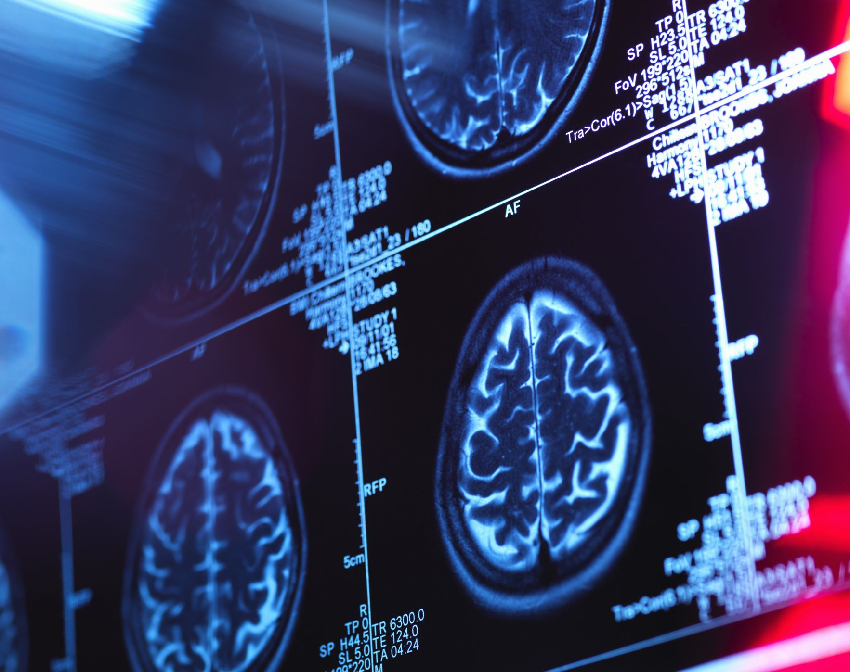
The Growing Utility of AI in Medicine
Matthew Wong, MD
Clinical Assistant Professor
Department of Neurology
Wake Forest School of Medicine
Notes:
So why am I presenting this talk on AI in medicine.
My main purpose is to outline the various algorithms and models that form modern artificial intelligence, and look at how they have been studied and implemented in medicine.
While it will be difficult to do justice to any of these areas, from deep neural networks, to machine learning to expert systems, I will attempt to touch on each of them to give you a broad sense of the subject.

Slide 6
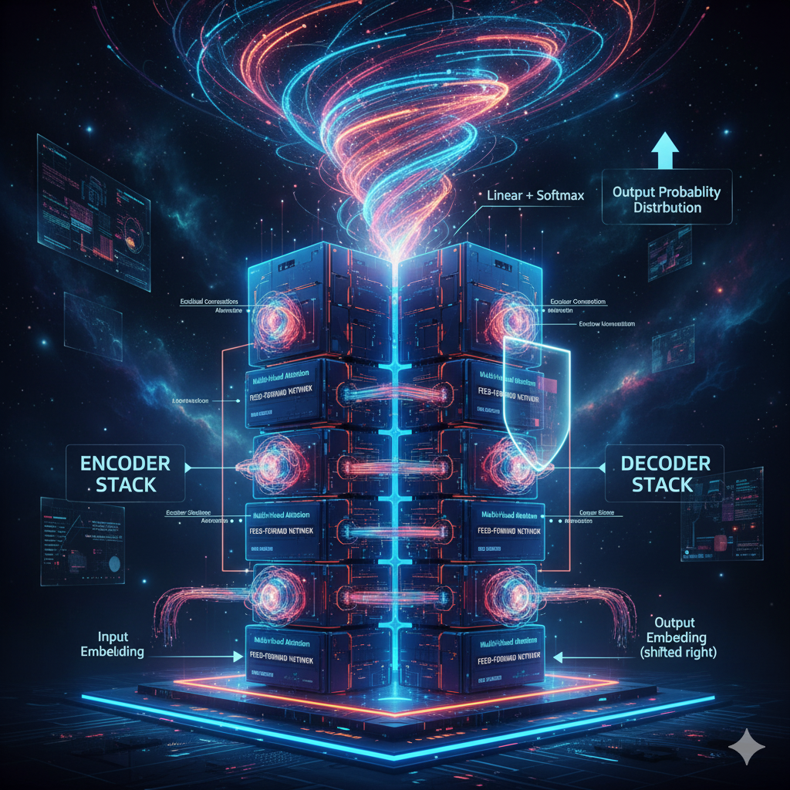
Objectives
To understand:
The definition of artificial intelligence.
The history of artificial intelligence in medicine.
Difference between AI, Machine Learning and Deep Learning
Its limited success and unfortunately its more common failures
Domains where it will become useful over time.
Look at the AI tools that I use in my day to day practice.
Notes:
My goal is to outline the various methods of artificial intelligence so that we can at least understand its various forms.

Slide 7
Pubmed Publications with AI or Artificial Intelligence in the Title
Notes:
Part of my motivation is based on the explosion of articles in pubmed that list AI in their title. We have gone from 200 or os artices in 2016 to probably 16000 or so articles in 2025. This does not even include articles where the title doesn’t mention AI, but rather particular approaches such as deep learning, deep neural networks and machine learning.

Slide 8
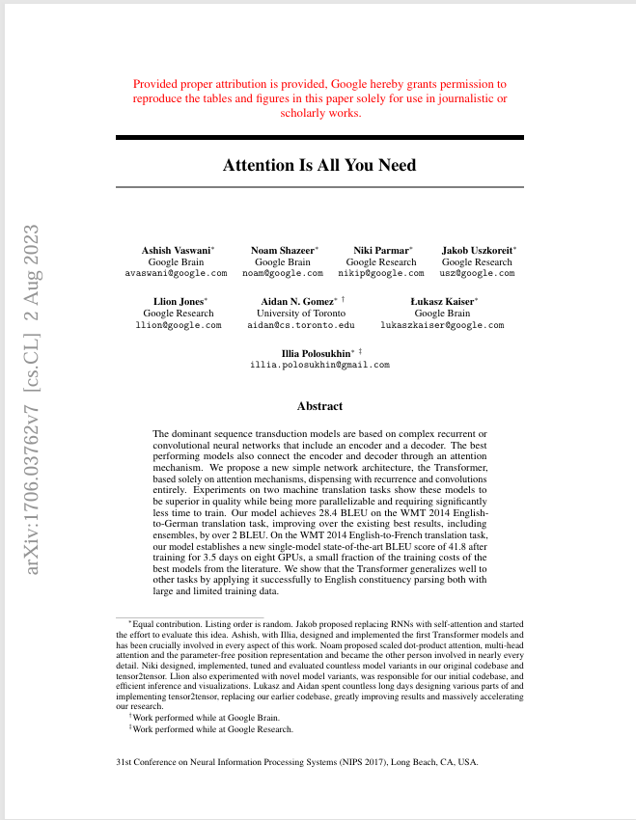
“Attention is All You Need”
Notes:
Despite AI being around for 50 years in medicine, it was not until this 2017 paper from the Google Brain group that kind of changed everything.
It introduced a new neural network architecture(the transformer) for language translation. It became the underpinnings for all the large language models that we use today.

Slide 9
Long Range Dependency Problem
The Problem Sentence
"The trophy didn't fit in the suitcase because it was too big."
What does "it" refer to? The trophy, or the suitcase?
Answer: the trophy (it was too big to fit).
Now translate to French — French adjectives must agree in gender with the noun they describe:
trophy → le trophée (masculine)
suitcase → la valise (feminine)
So the translation of "big" depends on which noun "it" refers to:
If "it" = trophy "trop grand" (masculine)
If "it" = suitcase "trop grande" (feminine)
Notes:
In particular in translation it helped the long range dependency problem.
So while the transformer solved this problem in translation its real contribution was its application to large language models.

Slide 10

Transformer Architecture
Created for language translation to solve the long range dependency problem.
The patient stopped clopidogrel before surgery because it was causing bleeding.
Also allowed for the disambiguation of word with same spelling but different meaning(polysemy).
The EKG lead was placed on the chest.
Exposure to lead can cause poisoning.
Notes:
This neural network architecture - the transformer - helped solve the long range dependency problem. In this first sentence, older architectures such as recurrent neural networks process text left to right and the nearest pronoun would be attached to the nearest noun – it to surgery. What transformers allowed every word is even over long ranges, would be compared and nd the model can look back even over many paragraphs to disambiguate words.
Similarily a similar mechanism allows the disambiguation of words such as lead in the example above.
However, despite being designed from translation this architecture became the underpinning of the large language model.

Slide 11
The Large Language Model
“A large language model is an AI system trained on very large collections of text, learning statistical patterns of language so that it can answer questions, summarize, translate, or generate new text in a human-like way.”
OpenAI’s GPT(generative pre-trained transformer) was the first commercially successful of these; The introduction of GPT 3 in May 2020 was the milestone, with the eventual release of ChatGPT built on GPT 3.5 in late 2022.
What was revolutionary was the evidence of transfer learning; the large language model could do tasks it was never trained on.
Translation
Arithmetic
Question answering
Writing software code

Slide 12
The Large Language Model in Medicine
Subsequent evolution of these models have added capabilities such as “thinking”, and have resulted in current models such as ChatGPT 5, Gemini 3, Claude Opus 4.6
Given medicine’s large reliance on textual data, excitement occurred about applying LLMs to tasks like note creation, summarization, patient question answering.
Also, the transformer architecture can handle multimodal data(images, video, sound) which is common in medicine.
However, large language models are only a one part of artificial intelligence.
Notes:
GIVEN medicines large reliance on textual data great excitement about applying large language models to medical problems like note creation, summarization and other tasks came to the fore front.
Given medicines large reliance on textual data, great excitement occurred about applying LLMs to tasks like note creation, summarization, patient question answering, etc.
However, large language models are only one small facet of artificial intelligence.

Slide 13
The Various Definitions of Artificial Intelligence
Classical(McCarthy - 1955) - "The science and engineering of making intelligent machines, especially intelligent computer programs.“
Philosophical - "The simulation or replication of human intelligence in machines, including reasoning and consciousness."

Slide 14
AI in Medicine: Timeline of Key Developments
1970s
1
MYCIN (1972-76): Stanford's rule-based system for diagnosing bacterial infections and recommending antibiotics.
2
1980s-1990s
Internist-I and QMR: Early diagnostic decision support systems widely used in medical education. Generate differential diagnosis.
1997
3
First Use of ML in Medical Imaging: Machine Learning methods applied to image classification in mammography and CT.
4
2012-2016
Deep Learning in Medical Imaging: CNNs applied to skin cancer classification, diabetic retinopathy, and radiology.
2018
5
First FDA Clearance of Autonomous AI: IDx-DR approved for diabetic retinopathy detection without clinician input.
6
2020-2022
Biomedical Foundation Models: BioBERT, PubMedBERT, CheXzero, GLoRIA, MedCLIP demonstrate generalization to unseen tasks.
2023
7
Generative AI in Clinical Discussion: GPT-4 passes USMLE-style questions;
Notes:
AI in Medicine has been around sinced the 1960s.
Initially there were rule based expert systems, that encoded expert knowledge to generate antibiotic recommendations MYCIN or differential diagnosis recommendations.
However, subsequent techniques focused on machine learning and now deep learning to solve clinical problems.

Slide 15
Artificial Intelligence
Machine Learning
Uses different algorithms to build models that learn from data without explicit programming(e.g. k-NN, SVM, linear and logistic regression), but do require “feature engineering”.
Deep Learning Uses multi-layered neural networks to learning relationships without feature engineering
Notes:
In medicine, there are two main techniques that have been popular over the last 30 years. Machine learning and now more recently deep learning.

Slide 16
Machine Learning
Machine learning is teaching a computer to recognize patterns by showing it thousands of examples, rather than writing the rules yourself.
Popular algorithms –
Linear Regression – predicts continuous outcomes
Logistic Regression – yes/no outcomes, classification
Decision Trees – classification
Random Forests – classification
Became popular with “big data”
Needs feature engineering – identifying the important variables to base predictions on.
Notes:
Demographics — age, sex, race/ethnicity. These are static and available at admission.
Vital signs — things like heart rate, blood pressure, temperature, respiratory rate, oxygen saturation. These update frequently and are classic early indicators of physiological stress.
Laboratory values — white blood cell count, lactate, creatinine, bilirubin, platelet count, blood glucose, and likely others. These are where much of the predictive power (and the data leakage problem) lives — because labs are often ordered because the clinician is already worried.
Comorbidities — pre-existing conditions from the patient's problem list or prior diagnoses (e.g., diabetes, immunosuppression, chronic kidney disease, cancer). These represent baseline risk.

Slide 17
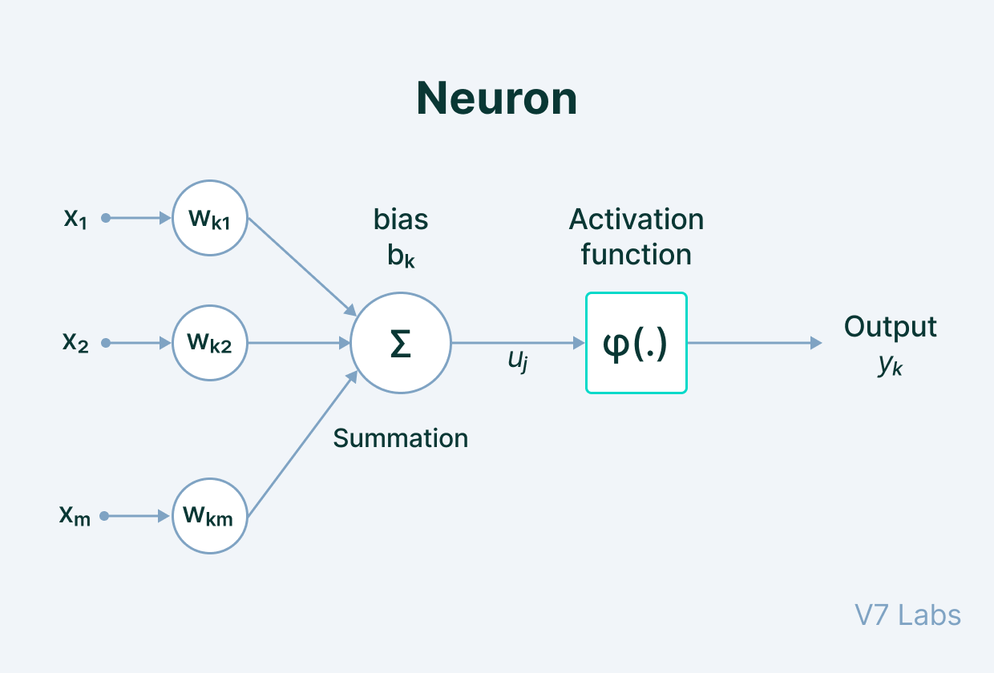
The Artificial Neuron

Slide 18
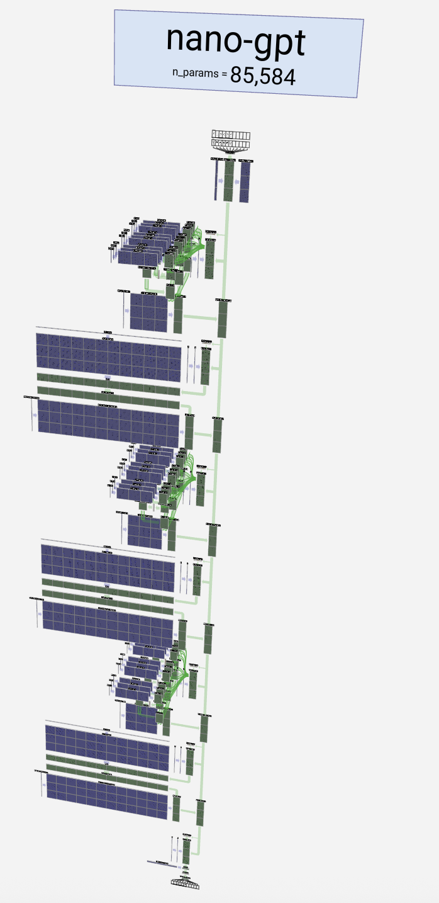
Deep Learning
Deep learning generally doesn’t rely on identifying the data that you want the algorithm to base itself on.
Refers to the many layers of the neural network
Refers to the depth of the hidden layers – GPT 3 has 96 layers.
Many different types
Image analysis – convolutional neural networks(CNN)
Time series data – recurrent neural networks(RNN)
Generative neural networks(GANs)
Graph neural networks.
Transformers
Notes:
The last point is important because a) makes the system a black box. B) Without

Slide 19
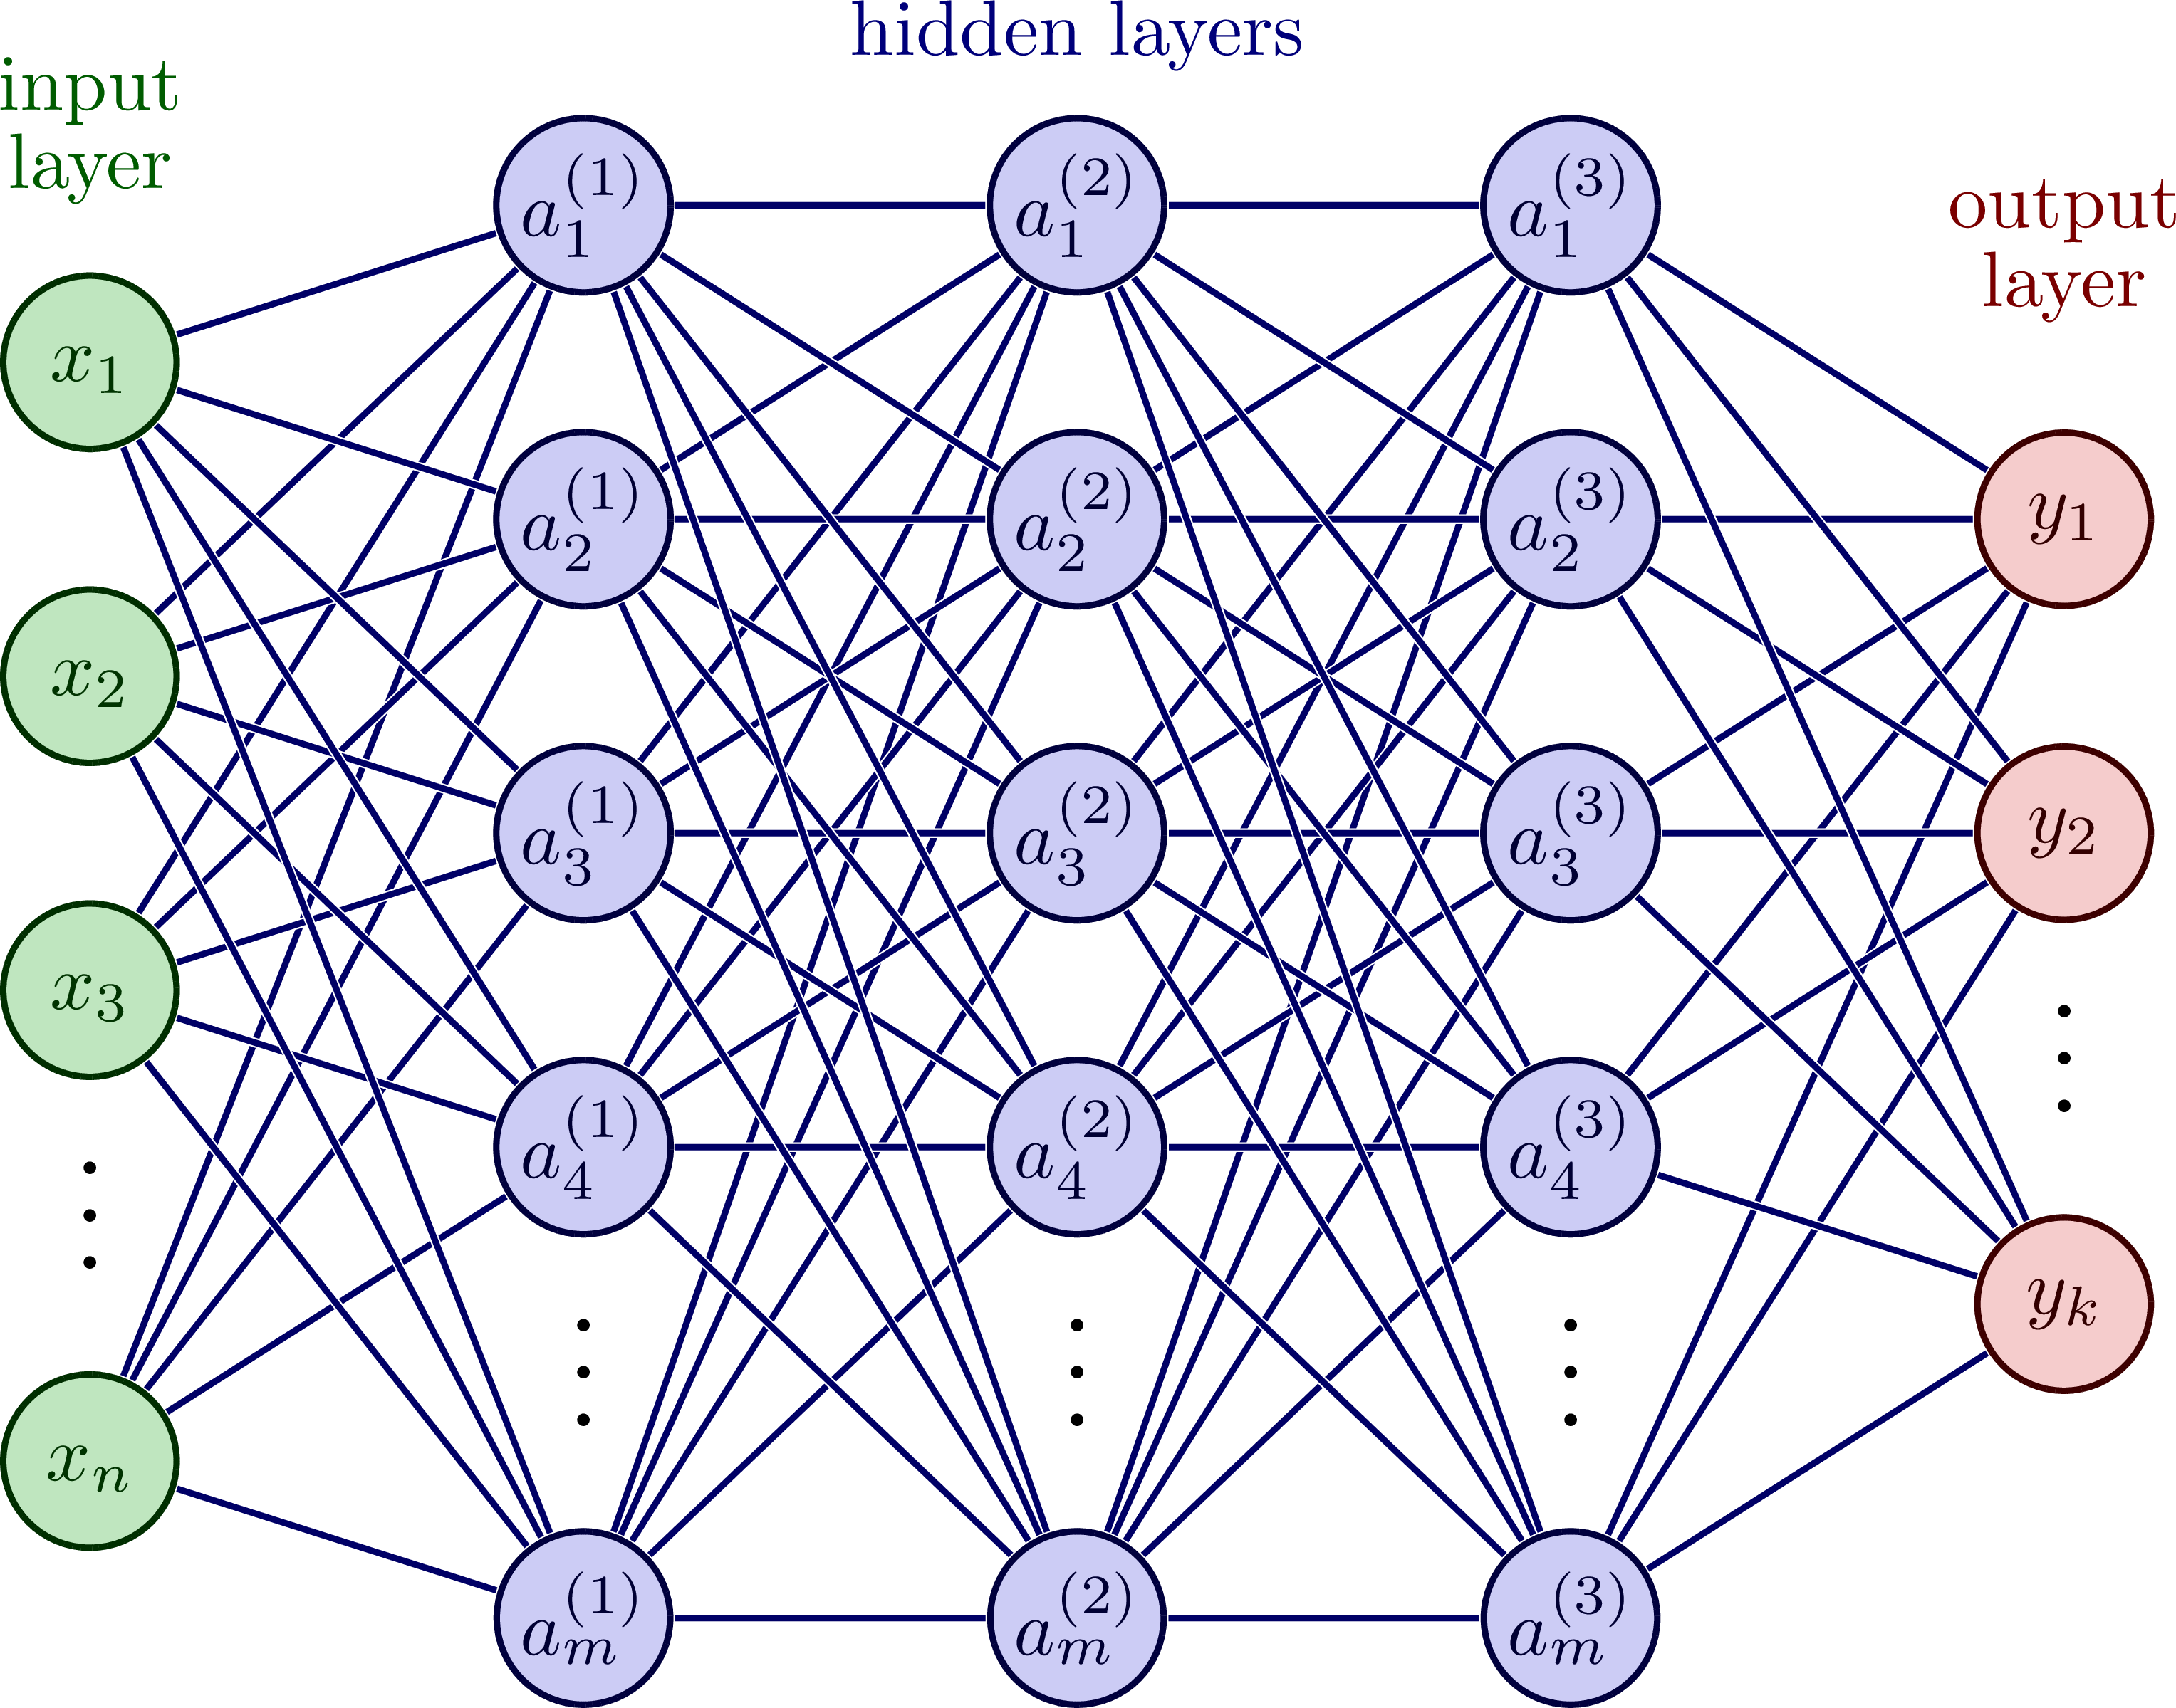
Neural Network

Slide 20
Deep Neural Networks, Pros and Cons Deep Learning
Advantages
Eliminates manual feature engineering
Captures complex non-linear patterns
Generalizability across domains.
Scalability with data
Problems
Data hungry
Black-box representations
Computational cost
Notes:
Advantages
Eliminates manual feature engineering
Traditional ML requires domain experts to design features (e.g., EEG frequency bands, imaging texture metrics).
Deep learning can learn directly from raw data (pixels, waveforms, text), reducing bias from human assumptions.
Captures complex, non-linear patterns
Networks can learn subtle hierarchical features (edges → shapes → objects in vision; phonemes → words → meaning in language) that humans may miss.
This often results in higher accuracy on complex tasks (e.g., seizure detection from EEG).
Generalizability across domains
Learned representations can sometimes transfer across tasks (e.g., pre-trained imaging models adapted to medical images with limited retraining).
Scalability with data
The model improves as more data are provided, without the need to redesign features.
Problems / Challenges
Data-hungry
Automatic feature learning requires large, diverse datasets.
In medicine, annotated data are scarce, costly, and subject to privacy restrictions.
Black-box representations
The learned features are often uninterpretable, making it difficult to know what the network is using to make decisions.
This is problematic in clinical domains that demand explainability.
Overfitting risk
If the dataset is small or biased, the model may learn spurious patterns (e.g., hospital-specific artifacts instead of disease signals).
Computational cost
Training models that discover features requires far more compute than using fixed, simple features with traditional ML.
Loss of domain control
In some cases, domain knowledge features (e.g., heart rate variability measures, neurophysiological biomarkers) can outperform learned ones, especially when data are limited.
Deep learning may ignore or underweight these unless explicitly integrated.
✅ In short:
Advantage → less reliance on human assumptions, better capture of complex patterns, scalability.
Problem → needs huge datasets, is hard to interpret, and risks learning irrelevant or biased features.

Slide 21
Expert/Rule Based Systems(MYCIN)
IF
the stain of the organism is gram-positive
AND the morphology of the organism is coccus
AND the growth conformation of the organism is chains
THEN
there is suggestive evidence (0.7)
that the identity of the organism is streptococcus.
IF
the seizure semiology includes sudden behavioral arrest
AND automatisms of the right hand are observed
AND the EEG shows rhythmic theta activity in the right temporal region
THEN
there is suggestive evidence (0.8)
that the seizure onset zone is in the right mesial temporal lobe.

Slide 22
AI in Medicine: Timeline of Key Developments
1970s
1
MYCIN (1972-76): Stanford's rule-based system for diagnosing bacterial infections and recommending antibiotics.
2
1980s-1990s
Internist-I and QMR: Early diagnostic decision support systems widely used in medical education. Generate differential diagnosis.
1997
3
First Use of ML in Medical Imaging: Machine Learning methods applied to image classification in mammography and CT.
4
2012-2016
Deep Learning in Medical Imaging: CNNs applied to skin cancer classification, diabetic retinopathy, and radiology.
2018
5
First FDA Clearance of Autonomous AI: IDx-DR approved for diabetic retinopathy detection without clinician input.
6
2020-2022
Biomedical Foundation Models: BioBERT, PubMedBERT, CheXzero, GLoRIA, MedCLIP demonstrate generalization to unseen tasks.
2023
7
Generative AI in Clinical Discussion: GPT-4 passes USMLE-style questions; LLMs explored for clinical decision support.
Notes:
MYCIN encoded clinical heuristic knowledge as IF–THEN production rules with certainty factors, mainly around infectious diseases and antibiotic therapy.
Used encoded knowledge from experts
IF
the stain of the organism is gram-positive
AND the morphology of the organism is coccus
AND the growth conformation of the organism is chains
THEN
there is suggestive evidence (0.7)
that the identity of the organism is streptococcus.
IF
the seizure semiology includes sudden behavioral arrest
AND automatisms of the right hand are observed
AND the EEG shows rhythmic theta activity in the left temporal region
THEN
there is suggestive evidence (0.8)
that the seizure onset zone is in the left mesial temporal lobe.
Whereas MYCIN focused narrowly on infectious disease and antibiotic selection, Internist-I was a broad differential diagnosis generator: it contained knowledge about ~500 diseases and ~3,500 findings.
🔹 How it worked
Knowledge was encoded as disease–finding associations, with weights representing how strongly a finding supported or opposed a disease.
The system worked in an iterative dialogue with the physician:
Doctor entered patient findings (symptoms, signs, labs).
Internist-I matched these against its disease database.
It ranked diseases by evoking strength (likelihood given the findings).
It suggested what additional findings to check to further narrow the differential.
Patient input:
Fatigue
Pallor
Low hemoglobin
High MCV (mean corpuscular volume)
Internist-I reasoning (simplified):
IF anemia is present
AND MCV is high
THEN consider megaloblastic anemia (evoking strength: 0.7)
ELSE IF MCV is low, consider iron deficiency anemia (evoking strength: 0.8)
Output to physician:
Most likely diagnoses:
Vitamin B12 deficiency anemia
Folate deficiency anemia
Suggested next step:
Order serum B12 and folate levels to differentiate.
Hand-crafted features + classical ML
Extracted features: edge sharpness, density, calcification shape, texture.
Algorithms: support vector machines (SVMs), k-nearest neighbors, random forests, logistic regression.
These were called CAD (computer-aided detection) systems.
Limitation: high false positives, modest improvement in radiologist performance.

Slide 23
Internist-I
Internist-I was a broad differential diagnosis generator: it contained knowledge about ~500 diseases and ~3,500 findings.
🔹 How it worked
Knowledge was encoded as disease–finding associations, with weights representing how strongly a finding supported or opposed a disease.
The system worked in an iterative dialogue with the physician:
Doctor entered patient findings (symptoms, signs, labs).
Internist-I matched these against its disease database.
It ranked diseases by evoking strength (likelihood given the findings).
It suggested what additional findings to check to further narrow the differential
Patient input:
Fatigue, Pallor, Low hemoglobin, High MCV
Internist-I reasoning (simplified):
IF anemia is present
AND MCV is high
THEN consider megaloblastic anemia (evoking strength: 0.7)
ELSE IF MCV is low, consider iron deficiency anemia (evoking strength: 0.8)
Output to physician:
Most likely diagnoses:
Vitamin B12 deficiency anemia
Folate deficiency anemia
Suggested next step:
Order serum B12 and folate levels to differentiate.

Slide 24
AI in Medicine: Timeline of Key Developments
1970s
1
MYCIN (1972-76): Stanford's rule-based system for diagnosing bacterial infections and recommending antibiotics.
2
1980s-1990s
Internist-I and QMR: Early diagnostic decision support systems widely used in medical education. Generate differential diagnosis.
1997
3
First Use of ML in Medical Imaging: Machine Learning methods applied to image classification in mammography and CT.
4
2012-2016
Deep Learning in Medical Imaging: CNNs applied to skin cancer classification, diabetic retinopathy, and radiology.
2018
5
First FDA Clearance of Autonomous AI: IDx-DR approved for diabetic retinopathy detection without clinician input.
6
2020-2022
Biomedical Foundation Models: BioBERT, PubMedBERT, CheXzero, GLoRIA, MedCLIP demonstrate generalization to unseen tasks.
2023
7
Large Language Models such as GPT-4 passes USMLE-style questions; LLMs explored for clinical decision support.
Notes:
Hand-crafted features + classical ML
Extracted features: edge sharpness, density, calcification shape, texture.
Algorithms: support vector machines (SVMs), k-nearest neighbors, random forests, logistic regression.
These were called CAD (computer-aided detection) systems.
Limitation: high false positives, modest improvement in radiologist performance.

Slide 25
Areas of Potential and Ongoing Use in Medicine
Diagnosis and Risk Prediction
Image Interpretation, Pathology Interpretation
Treatment Planning and Precision Medicine
Therapeutic recommendations, Radiation Planning, Pharmacogenomics
Monitoring and Management
Disease progression, Chatbots and Virtual Health Assistants, Wearable and remote monitoring.
Operational and Administrative Efficiency
Triage and Scheduling, Clinical Documentation, Clinical Summarization
Drug Discover and Development
Molecular Modeling(e.g. AlphaFold2), Clinical Trial Matching,
Education and Training
Simulation of Patients Encounters
Adaptive Learning
Literature Review.

Slide 26
Neurology Original Research Articles – Deep Learning

Slide 27
Barriers to Deployment
Category | Barrier
1. Regulatory | ❌ Lack of FDA or CE approval
2. Clinical Validation | ❌ Lack of prospective trials
3. Workflow Integration | ❌ Hard to embed into EHRs, PACS, or clinical flow
4. Trust and Interpretability | ❌ “Black box” concerns
 | ❌ Fear of liability
5. Reimbursement & Business Case | ❌ No CPT codes or billing pathways
 | ❌ No financial incentive for adoption
6. Data Quality & Infrastructure | ❌ Messy, incomplete, or delayed data
 | ❌ EHR heterogeneity
7. Equity and Bias | ❌ Underperformance on certain populations
 | ❌ Lack of representative training data

Slide 28
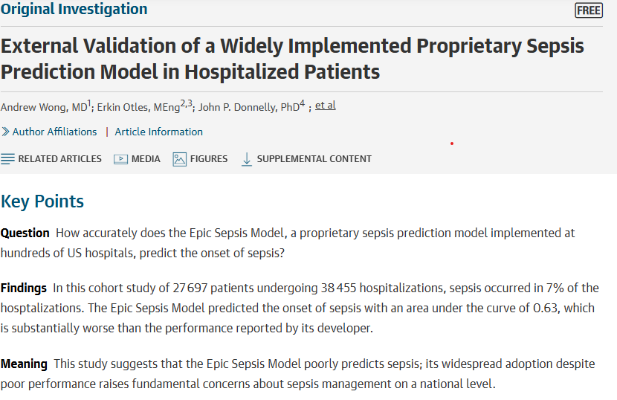
Epic Sepsis Model – An Epic Failure
Notes:
Machine learning logistic regression model to help clinicians identify sepsis.
In a cohort of about 27,700 patients, the researchers found the ESM predicted sepsis with an AUC of just 0.63 — substantially worse than the 0.76–0.83 range Epic reported. PubMed Central At the threshold Michigan Medicine adopted (within Epic's suggested range), the tool had a sensitivity of only 33%, meaning it missed two-thirds of sepsis patients, while still generating alerts on 18% of all hospitalized patients — creating a significant alert fatigue burden

Slide 29
Key Findings
Evaluated Epic Sepsis Model (ESM) at Michigan Medicine (University of Michigan) across over 27,000 patients.
Found that the model:
Missed 67% of sepsis cases not flagged in advance
Had low sensitivity (~33%) for early detection
Generated many false positives, contributing to alert fatigue
Was not transparent or interpretable (proprietary black box)

Slide 30
Poor Engineering
Training Bias and Overfitting
Training data was likely overfitted to Epic’s development environment
Never validated on diverse data.
Likely learned relationships that don’t hold out of the original training set
E.g. Might have learned patterns based on the hospital’s workflow, note templates
Admitted to ICU -> high risk of sepsis.
Data Leakage
Data was allowed to be used for training, that shouldn’t have been included. For example, it is likely that an anti-biotics order, ordering blood cultures, sepsis diagnostic code was a predictive variable(temporal leakage).
Model was not FDA approved, although that doesn’t necessarily help.
Notes:
Data leakage is when your model accidentally gets access to information during training that it wouldn't have in the real world at the time you'd actually want a prediction. It makes the model look great on paper but useless (or misleading) in practice.
Here's a really simple example:
Say you're building a model to predict which patients will develop sepsis early, so clinicians can intervene sooner. You pull a bunch of variables from the EHR to train on — vital signs, lab values, demographics, medications. Sounds reasonable.
But buried in your training data is a variable like "blood culture ordered: yes/no." The problem? Clinicians order blood cultures because they already suspect sepsis. So your model learns: "if blood culture ordered → high risk of sepsis." It gets a fantastic accuracy score during testing.
But in the real world, by the time the blood culture is ordered, the doctor already knows something is wrong. Your model isn't predicting sepsis early — it's just confirming what the clinician already figured out. The "future" information leaked into your training data.

Slide 31
AI Adoption in Health Care will be Slow
Regulatory
FDA Approval, Liability Concerns, Changing Regulations
Clinical Trust and Work Flow Integration
Black Box Models, Disruption to work flow, Alert fatigue
Data Quality
Dirty or incomplete EHR data, Interoperability Problems, Lack of Real time access, Data quantity
Economic Barriers
Model Generalizability – Bias and equity concerns, Need for site specific tuning
Lack of Prospective Validation

Slide 32
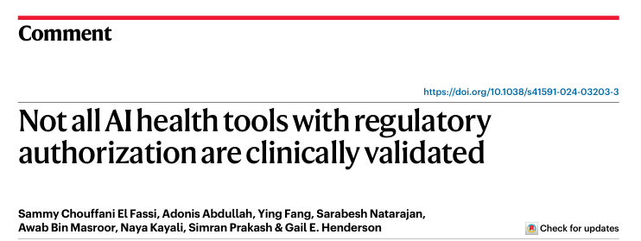
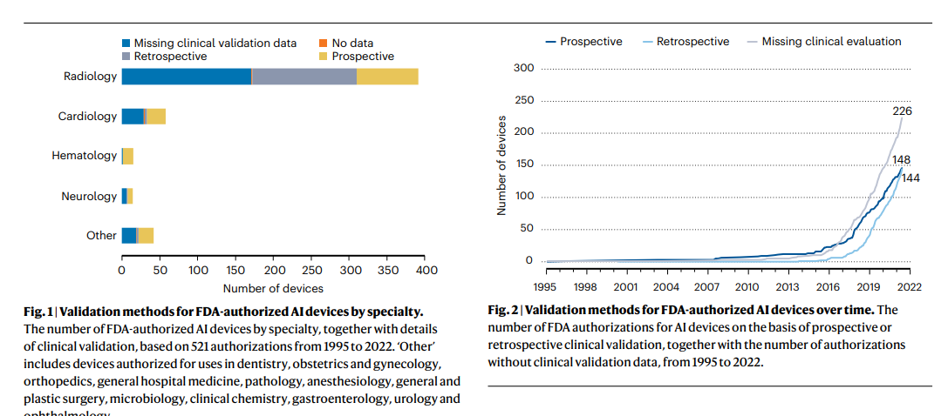
Notes:
From 2016 to 2022, the average number of medical AI device authorizations by the FDA per year has increased from 2 to 69, indicative of growth in commercialization. Of the 521 device authorizations, 292 (56%) reported clinical validation; of these, 144 (27.6%) were ‘retrospectively validated’ and 148 (28.4%) were ‘prospectively validated’. A subset of 22 (4.2% of total authorized devices) with prospective validation were more specifically ‘RCT validated’. For 226 (43.4%), clinical validation data were missing. Only three (0.6%) lacked publicly available decision summaries. The number of authorizations with missing clinical validation data surpassed the numbers of retrospectively and prospectively (including RCT)-validated devices in every year since 2016 (Fig. 2).

Slide 33
FDA Tools Still Need to be Validated
IDx-DR (now Digital Diagnostics)
Received FDA clearance in 2018 for autonomous detection of diabetic retinopathy.
One of the best validated systems.
Real-world studies conducted in primary care settings revealed challenges such as poor image quality, workflow inefficiencies, and reduced sensitivity in certain demographics, resulting in fewer completed screenings than anticipated.
FDA-Cleared AI Models for COVID-19 Chest X-rays
Several models received expedited FDA clearance during 2020–2021.
Many were later found to be trained on limited and biased datasets, including reliance on hospital metadata labels (e.g., portable chest X-rays being labeled COVID-positive).
A 2021 review concluded that most models failed external validation.
Reference: Roberts et al., Nature Machine Intelligence, 2021. https://www.nature.com/articles/s42256-021-00307-0

Slide 34
Opportunities for Validation Research
Real-world performance | Does the model still perform when used by real clinicians? Does it continue to perform(model drift)
Generalizability | Does the model work in rural, pediatric, or safety-net hospitals?
Head-to-head comparison | Which AI sepsis tool performs best under the same conditions?
Bias & fairness | Does the tool underperform on underrepresented populations?
Workflow integration | How do clinicians respond to the model’s outputs?
Cost-effectiveness | Does the model save money or improve efficiency?

Slide 35
Back to the Transformer
Main uses in health care currently
Ambient dictation – uses a transformer for speech recognition, and then another transformer(in DAX Copilot case), GPT to write a note from a conversation.
Chart summarization – extract the important parts of the chart for a provider.
Inbox management – some centers have experimented with replying to patient queries.
Chatbots – answer medical questions, can be fine tuned for a particular specialty.

Slide 36
Transformers used in 3rd Party tools
OpenEvidence
ChatGPT, Claude, Gemini
NotebookLM from Google

Slide 37
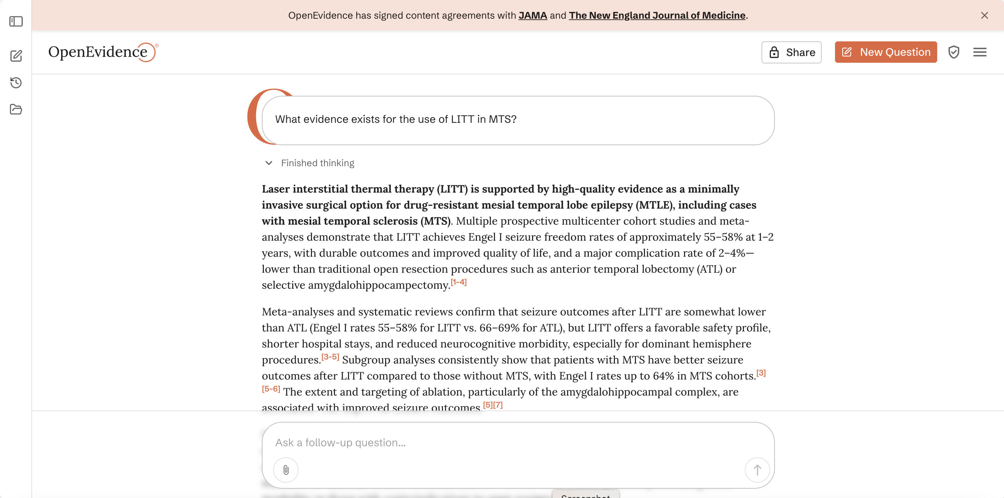

Slide 38
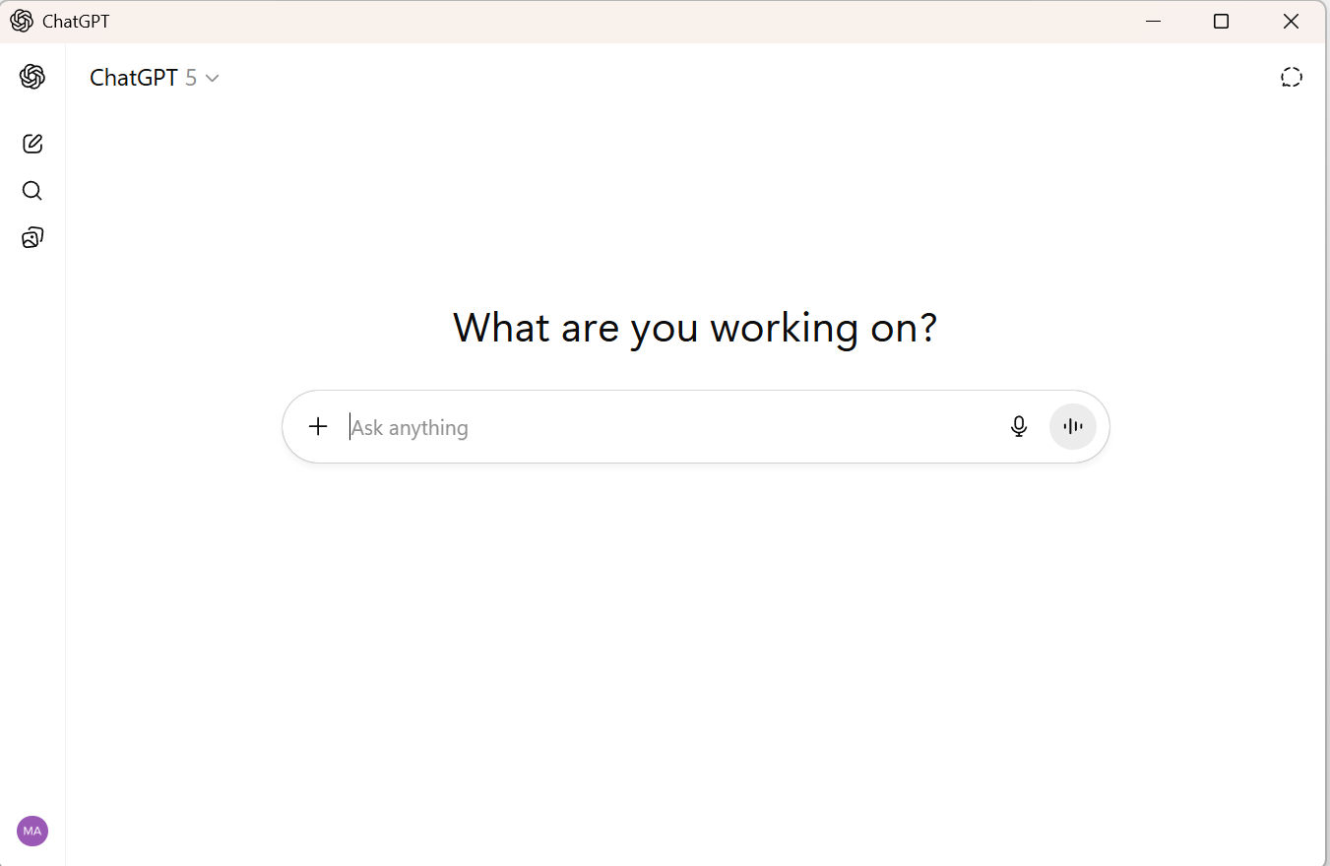

Slide 39
Conclusions
Artificial Intelligence in Medicine are showing promise
However, there is a long ways to go between research and eventual implementation.
As clinicians and researchers we have to be vigilant about the how these tools are validated.
The FDA is unlikely to be a suitable organization for the validation of these tools.
Commercial AI based tools deserve extra scrutiny.
There still remains potential utility of AI, in particular deep learning and transformers in medicine and neurology.

