Slide 1

Pediatric ASCH Conference
Additional Applications of Hypnosis in
the Pediatric GI setting
“Placing language, rapport at the center of care”
March 1, 2026
Ana Maria Verissimo MD, MA
Resilience Through Reflection, LLC
Resiliencethroughreflection.org
resilience4now@gmail.com
‘Retired’ Director of Pediatric Integrative Medicine
Connecticut Children’s
Former Assistant Professor of Pediatrics
University of Connecticut School of Medicine

Slide 2

Disclosure
I am the owner of Resilience Through Reflection, LLC
I have no actual or potential conflict of interest in this presentation
I will not discuss ‘off label’ use(s) or investigational use (s) of medications and/or procedures in this presentation

Slide 3

Presentation Objectives
Introduce hypnosis applications within the pediatric GI clinic: helping your patient find their ‘happy place’ in the medical encounter
Dr Vlieger has discussed applications of pediatric hypnosis for gut-brain disorders
Hypnosis to assist in Anorectal Manometry
How assist patients with needle phobia

Slide 4

Introduce hypnosis applications within the pediatric GI clinic: helping your patient find their ‘happy place’ in the medical encounter
Pre -Review medical chart: include past experiences (if applicable) with current medical procedure.
RAPPORT: Introduce yourself and ‘your role’ in being present today. Introduce, discuss Hypnosis topic-Are you ie patient, family, caregiver familiar with hypnosis? What does hypnosis mean to you? ~educate, clarify
Obtain consent/assent – state specific
Ask patient do you know why you(patient) are at the clinic today?
Assess developmental status of patient as this assists with hypnosis session specifics

Slide 5
Introduce hypnosis applications within the pediatric GI clinic: helping your patient find their ‘happy place’ in the medical encounter
Continue building rapport: even if this is not your first encounter together.
Is your patient wearing a ‘fun’ shirt with design ‘cartoon’ which can ‘let you into their world of interest, imagination’ ? Any supportive toys?
Ask do you attend school? What grade- favorite subjects, activities?
Do you have brothers/sisters? Any pets?
Ask child what do they like to do for fun? Favorite place to visit? What kinds of things make you laugh? Favorite activities? Favorite movies? Favorite music?
Do you ever Notice how your mind can wander, daydream and be ‘open’ for imagination?
If patient does not respond, ask your patient if you can ask their parent/caregiver these questions. Then direct the following to your patient: “When you allow your words to easily flow then I can learn even more about you.”

Slide 6

Case study: Hypnosis for 7 y.o. female undergoing first Anorectal Manometry examination study
Medical chart review: 7 y.o. female with chronic constipation scheduled for her first Anorectal Manometry exam. She has ‘anxious tendencies’ especially with medical encounters and procedures.
Establish Rapport with patient and family/caregiver
Hello, I’m Dr Verissimo-you can call me Dr Ana if you like. It’s so nice to meet you. I’m here today to help you use your own skills to relax during this exam. I know you already have so many ways to help your body feel calm, relaxed, and focused. I’d love to learn how you do this. Maybe you can share some of those skills with me now? Thank you!
I know my brain can sometimes be a little ‘bossy’ especially when I’m worried, bothered, angry, unsure. Do you know what ‘bossy’ means? Yes, that’s right! Have you ever noticed that your brain can be bossy like mine? I see. It happens to everyone. I’d love to teach you a few ways I’ve learned to ‘Be the Boss of my Brain. Is that OK? Great! Let’s start learning together.
I Noticed that she brought an iPad and a puppy stuffed animal with her. Furthermore, I noticed that she wore a shirt with rainbows, flowers and butterflies~ These are all important clues to help encourage participation and assist with hypnosis session specifics. This can further build Rapport.

Slide 7
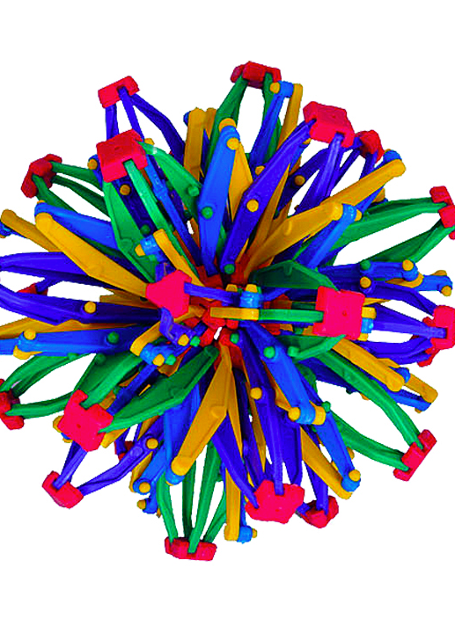
Case study number 1 continued
2. Introducing ‘belly breathing and incorporate ‘clues’ she’s brought with her. “I see you brought your iPad and a very special stuffed animal. Maybe we can ask your puppy to be a helper too? Is that OK? Great! Thank you! What’s your puppy’s name? Oh, Wallis Rose –what a beautiful name!
As you may remember, I’ll be your helper while your doctor and nurse will also help you with the procedure. I would like to show you a new fun way to ‘use your powerful breath’ which you can use to help you relax. Would you like that? Everywhere we go we bring our breathing, right? It’s up to you. You are ‘in control’
I then show her my Hoberman sphere as a ‘visual Tool’ I demonstrate slow deep belly breaths including Hoberman sphere- open and close, expand and contract just like belly breathing. With each breath in and out I can feel more relaxed, in control, calm,focused. That’s right. I placed her stuffed puppy, Wallis, on her belly. She then gave Wallis a ride on her belly’ by using her abdominal breathing. “You are doing this ‘just right! You are so good at this! Can you feel that relaxation, calm ? How wonderful!
Can you now lie on your side? Thank you. Notice your slow in-breath and slow outbreath. Very good You can keep your eyes opened or closed, just noticing your breathing, in and out, in and out. It’s up to you. With each breath you may notice feeling more and more relaxed. Maybe you are already noticing a lovely warm feeling that spreads with every breath…That’s right every breath allows you to feel more and more relaxed and more in control too. Isn’t that so interesting and so good to know? You are the boss of your mind, your body. You can use the ‘power of your breath’ to be in control. It’s so easy to do!”
Hoberman sphere

Slide 8
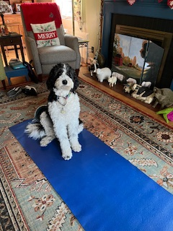
Case study number 1 continued
3. Favorite place imagery: Would you like to use your imagination to travel in your mind –daydream? The doctor and nurse are over ‘there’ doing what they need to do to help you with this procedure, but you don’t have to pay attention. If the doctor or nurse asks you to do something during the procedure, or ask you a question, you can easily, effortlessly do what they ask and then be even more relaxed and continue your favorite place adventure. Is that OK? Great
Shall we have Wallis join you on your adventure? How wonderful! As you hold Wallis in your arms, feel her fur, soft, -just like your puppy at home. You can gently rub Wallis’ fur and smell her too, see her in your imagination.
You can talk to me with your own voice, words or you can squeeze Wallis’ paw up-Yes, down is No -when I ask you a question. You choose. You are doing this just right. I wonder where you’ll go in your imagination? You have such a pretty shirt with beautiful flowers, and butterflies and even rainbows. I wonder if you’ll go to a fun garden? It’s up to you. Are you there yet? You can use your words or raise Wallis’ paw up yes/down as a No Patient answered Yes– How wonderful. Continue breathing in and out. That’s right ! You are so good at this!

Slide 9
Case study number 1 continued
I invite you to allow your mind to really enjoy where you are. Maybe the flowers have bright unusual colors, what do you hear/ smell/ touch even taste! It’s all up to you. Can you tell me where you are? A garden- with flowers. How fun! Thank you for sharing! Maybe its like your pretty shirt with flowers, butterflies, and rainbows- It’s up to you. Is Wallis there too? She running after butterflies to play! Is there a Rainbow too? I wonder if you would like to climb with Wallis to the top of the rainbow and see all the beauty below? You do!! How fun. Sliding down holding Wallis’ paw easily, effortlessly –laughing, smiling all the way down. It’s so nice to slide down the rainbow, fun going down a slide~easily
I will incorporate ease of slide/chute imagery soon in session -suggestion

Slide 10

Case study number 1 continued
I wonder if you can think of a ‘way to remember’ to use this special new skill,Tool ~ some children I’ve worked with chose to squeeze 2 fingers together, some choose a smile or grin. I know that when you choose your special ‘reminder’ then you will use your breathing, imagination ~ self hypnosis so well. Did you choose your reminder? How lovely finger tap~ Just like you tap your iPad for a special game you can now ‘tap’ your fingers and be in control using your self hypnosis. Hooray! (anchor)
Notice how your body feels in this special place you’ve created in your own mind. And you can go there anytime you like- you can stay as long as you like too. It’s a gift you can give to yourself. Maybe you can imagine the rainbow slide and how fun it was to slide down with Wallis. You have such a wonderful imagination. I wonder if there’s anything else you can imagine that can now easily effortlessly slide down a ‘pretend chute’ ? That’s right…a ‘poop’ You are so good at this new brain/mind ‘game’

Slide 11

Case study number 1
4. Trance termination: before we are finished, in the next few moments, I would like you to remind yourself of what you learned using the power of your breath and you imagination. You are so good at self hypnosis. I wonder when you’ll use this ‘special gift’ again~ to be in control. The more you practice, the easier it will be. Just like you practice playing piano and soccer drills. You should be very proud of yourself. And you have chosen to ‘tap your fingers’ to remind you!
In the next few moments, I invite you to take deeper breaths, feel your fingers and toes move, next hearing the sounds of the examination room, the beeps/buzzes of the room And then you can open your eyes and be proud of all you learned and did today.

Slide 12

Needle Phobia: 9 y.o. male with leukemia: Magic Glove
Chart reviewed
Discussed ‘Magic Glove’ technique to assist ‘mind’ analgesia with parent and child. They had already viewed Dr Kuttner’s Magic Glove video Patient has worked with Child Life Specialists to learn relaxation strategies
Please note at Connecticut Children’s we used 2 different topicals to assist with procedural discomfort. These medications placed 60 min before IV insertion or shot. In order to establish patient/family confidence therefore building rapport these medications need to be placed for appropriate time. Importance of Child Life Specialists cannot be overstated
The patient enjoyed playing basketball, ice hockey and loved watching these sports on television and through via games. He also enjoyed ‘magic’ videos and was curious about the ‘Magic Glove’ technique

Slide 13

Needle Phobia: Magic Glove continued
We started the session with slow deep abdominal breathing. He also wanted to incorporate progressive muscle relaxation.
We tested both hands prior to magic Glove application and they felt the same. He wanted the glove to be placed on right hand. The Magic Glove was placed after ‘numbing cream’ was added onto his hand through imagery. There was just the ‘right amount of cream and the right amount of time’ He then added sky blue sparkles to make the magic glove work even better. He was able to close his eyes to assist the hand in becoming even sleepier. WE tested the effect of the Magic Glove and he felt a difference in right hand versus left hand. I continued with ego strengthening language, He then was able to transfer the numbness to her left hand. With further support he then transferred the numb/sleepy sensation to left upper outer arm (in case future shot) He was surprised and thrilled with his own ability to experience this phenomenon. I then 'removed' the Magic Glove and made sure that all areas were back to normal sensation.

Slide 14

Needle phobia: 13 y.o. male with cystic fibrosis
As discussed in previous slides: Chart Review, Build Rapport, Discussion of hypnosis and specific use for this session, Consent, assent . Reviewed his ‘Imagery Questionnaire’ answers-he loves the outdoors: skiing, ice hockey, kayaking. We also had a discussion of his prior experiences with ‘needle’ interventions. He has used breathwork and imagery in past Child Life-partial success. He was eager to learn more.
Session started with his selection of a small seashell from my collection as a ‘gift’ he gives himself for being here today and being curious of how he can use self hypnosis. He then closed his eyes and started using slow deep abdominal breathing- though I chose not to focus ‘so much’ on breathwork given cystic fibrosis- I then suggested progressive muscle relaxation starting with his toes and slowly moving up his body. Emphasizing tight muscle then release…with outbreath
He was able to talk and use ideomotor signaling with head nod throughout session. Next, favorite place imagery. Once there, enjoying where he was. Ego strengthening language-you are doing this just right Great job! His ‘anchors’- seashell and thumb to index finger- to remember this feeling of relaxation and control, ease of acquiring.

Slide 15

Needle phobia: 13 y.o. male with cystic fibrosis
I then introduced ‘concept’ of brain as a computer. We can delete unhelpful files- such as negative past discomfort experiences- and replace with new files. We can also imagine a computer screen which has dials/on off switch/ I wonder what you decide to choose in order to ‘not pay attention’ to next needle procedure? Will you ‘turn off’ discomfort/bother switch? Or decrease volume or delete altogether for that moment? Or something else? It’s up to you. That’s right It’s up to you. You are in charge of your brain/computer. Perhaps once you’ve decided you can let me know with head nod or use your words. He then nodded. That’s great.
You can continue to enjoy your favorite place. Truly be ‘there wherever there is.. Perhaps explore sights, sounds, smells, touch and even taste to the fullest Notice how your body feels when you’re in this place you’ve chosen Remember you can be there anytime, for a long or as short as you like. That’s right! Great job! Take in all those good feelings with you. A present you give yourself.
Learn to be silent.
Let your quiet mind listen…
and absorb. Pythagoras

Slide 16
Needle phobia: 13 y.o. male with cystic fibrosis
In a few moments, I’ll ask you to gently return to this room Perhaps you can gently move your toes, feet, hands, arms whatever you like to gently return to this room. Notice sounds of the room and my voice When you’re ready, you’ll be back here with me
That’s right Great job!! Are you totally back? Great! Perhaps you can share this experience with me?- if you choose to
He used on/off Pain switch –red (on)/yellow in between- to green (off) pain.
He imagined himself in exam room prior to IV insertion. He accessed his computer to be sure it was in ‘green mode’ He shared he doesn’t always want it to be in green because as an athlete, he needs to know if/when he feels pain. Amazing! He ‘saw himself ‘get the IV’ but by that time he was in a favorite place
You may Notice that I did ‘less’ talking with this patient.
He had already demonstrated successful use of his relaxation Toolbox
I did not want to ‘interfere’ but yet – our mind will pay attention/or not as needed.

Slide 17

Thank you
The greatest discovery of my generation is that human beings, by changing the inner attitudes of their minds, can change the outer aspects of their lives. William James
Ana Maria Verissimo Prieto MD,MA
My contact info:resilience4now@gmail.com
Resiliencethroughreflection.org

Slide 18
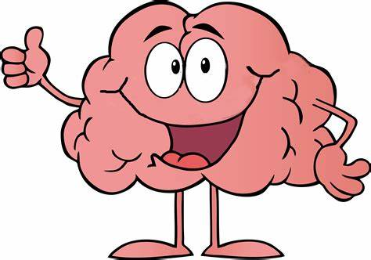
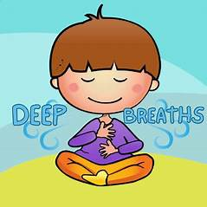

Ana Maria Verissimo-Prieto, M.D. Resilience Through Reflection, LLC TM resilience4now@gmail.com
Your brain can help you stay ‘in control’ even when your emotions want to ‘take’ control.
It’s easy… it takes practice …and you get to create what’s best for you.
Hello, I’m your brain.
A few skill set suggestions
B-breathe to balance
R-remember my relaxation skill set
A-awareness of my thoughts, body sensations, and feelings
I- invite new ideas into my self control skill set
N-notice how I feel
B.R.A.I.N TM

Slide 19
References
Baaleman DF, Vriesman MH et al. Hypnosis to Reduce Distress in Children Undergoing Anorectal Manometry: A Randomized Controlled Pilot Trial. J Neurogastroenterol Motil 2022;28:312-319.
Vlieger A et al. Gastroenterology Committee of ESPGHAN. Hypnotherapy in Pediatric Gastroenterology. J Pediatr Gastroenterol Nutr. 2023 January 1:76 (1):9-13.
The Life-Changing Power of Self-Regulation Tools | Psychology Today Dr Ran D Anbar ‘Understanding hypnosis’ https://www.psychologytoday.com/us/blog/understanding-hypnosis/202504/the-life-changing-power-of-self-regulation-tools
Cystic Fibrosis Foundation Guide ProceduralAnxiety https://www.cff.org/managing-cf/procedural-anxiety

Slide 20
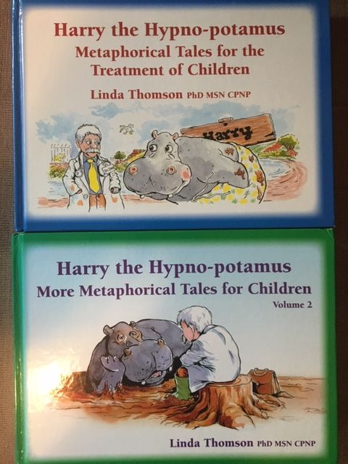
Favorite
Books
These 2 Volumes
provide many
delightful stories through which ‘solutions’
are ‘offered’ via ‘hypnosis’
A ‘must’ for the Healthcare
Provider interested in showing/sharing /teaching
The Power of Hypnosis
-Ana Maria Verissimo MD

Slide 21


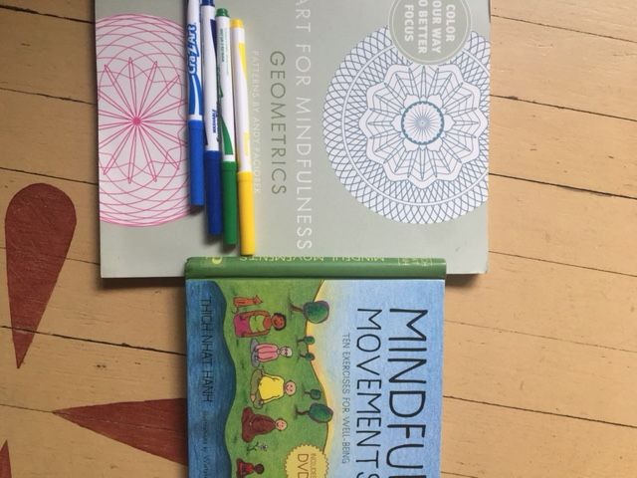

Books

Slide 22
Pediatric Hypnosis Books
Kohen, D. and Olness, K. Hypnosis and Hypnotherapy with Children (4th ed) Routledge-Taylor and Francis, 2011
Wester, WC and Sugarman LI (eds): Therapeutic Hypnosis with Children and Adolescents Crown House Publishing, Wales. 2007
Anbar, R. Functional Respiratory Disorders When Respiratory Symptoms Do Not Respond to Pulmonary treatment, Humana Press, Springer, 2012
Lyons, Lynn Using Hypnosis with Children: Creating and Delivering Effective Interventions WW Norton and Company, New York. 2015

Slide 23
Integrative and Hypnosis Texts
Culbert T, and Olness K. Integrative Pediatrics, Oxford University Press, 2009
Zeltzer, L. and Schlank C. Conquering Your Child’s Chronic Pain, Harper Collins, 2005
Thomson, L. Harry the Hypno-potamus, Metaphorical Tales for The Treatment of Children, Crown House, 2005 Vol 2 2009
Thomson, L. Harry the Hypno-potamus, Metaphorical Tales for The Treatment of Children, Crown House, 2005 Vol 2 2009
Zeltzer, L. and Schlank C. Conquering Your Child’s Chronic Pain, Harper Collins, 2005

Slide 24

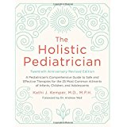

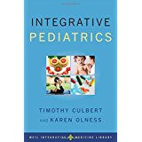



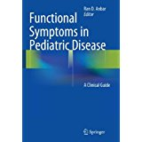

Slide 25
Integrative Medicine Resources
AAP Section of Complementary and Integrative Medicine
https://nccih.nih.gov (National Center Complementary and Integrative Health)
COCHRANE Review
The American Holistic Medical Association
https://www.consumerlab.com
www.naturaldatabase.com
hhttp://www.imconsortium.org Academic Consortium Integrative Medicine and Health
Professional Journals: Pediatrics, Peds in Review, Contemporary Pediatrics, Ped Clinics North America
www.liebertpub.com/.../alternative-and-complementary-therapies Alternative and Complementary Therapies Journal
https://integrativemedicine.arizona.edu

Slide 26
Hypnosis Teaching Organizations
American Society of Clinical Hypnosis (ASCH)
www.asch.net
National Pediatric Hypnosis Training Institute(NPHTI)
www.nphti.org
Society for Clinical and Experimental Hypnosis (SCEH)
www.sceh.us
New England Society Clinical Hypnosis (NESCH)
www.nesch.org

